Slide 1
CSC402:PROGRAMMING I
CHAPTER 2: ALGORITHMIC PROBLEM SOLVING
(FORMATTING OUTPUT)

Slide 2
FORMATTING PROGRAM OUTPUT
Include the header file:
#Include <iomanip>
Manipulators in a cout statement:
setw(n)-Set field width to n
setfill(n)-Sets fill character to n
setprecision(n)-Sets floating-point precision to n

Slide 3
INPUT OUTPUT MANIPULATOR
Most system divide a page of text output into twenty five rows and eighty columns.
Example:
Suppose you want to create three column of output: Student’s Name, Student’s ID and Student’s Program.

Slide 4
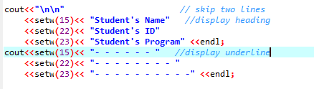

INPUT OUTPUT MANIPULATOR
Source Code:
Output:

Slide 5

INPUT OUTPUT MANIPULATOR
setfill(n)
Specifies character for blank space in field
Single quotes required around character enclosed in parentheses
Example:
Output:

Slide 6
INPUT OUTPUT MANIPULATOR
Generating Left-Justified Value
Specifies character for blank space in field
cout.setf(ios::left);
By default, when we use setw(n) to print values or information, the values are right justified.
So to put as left justify we must write the above statement.

Slide 7


EXAMPLE
Source Code:
Output:

Slide 8
FORMATTING OUTPUT VALUE
Generating Decimal Point Value
Example:
cout.setf(ios::fixed);
Fixed decimal output
without exponential.
cout.precision(n);
Dictates the number of
decimal places.
cout.setf(ios::fixed);
Input: 12.34567
Output: 12.34567
cout.precision(3);
Input: 12.34567
Output: 12.346

Slide 9
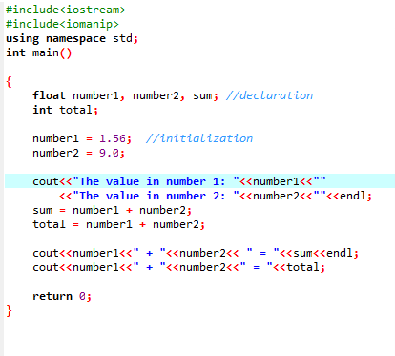

UNDERSTANDING FLOATING POINT NUMBERS

Slide 10
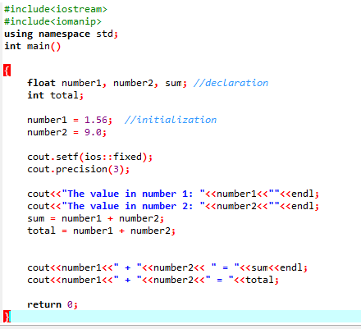

UNDERSTANDING FLOATING POINT NUMBERS

Slide 11
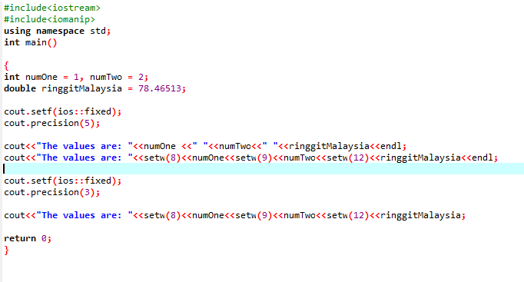
EXAMPLE
Source Code:

Slide 12
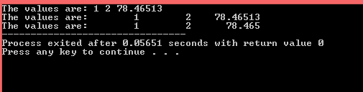
EXAMPLE
Output:

Slide 13
THANK YOU
Any questions?

